Slide 1

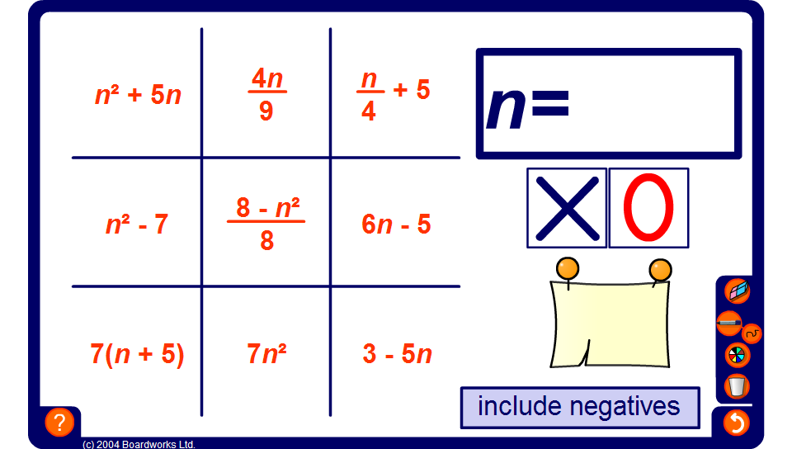

Noughts and crosses – substitution
Notes:
Divide the class into two teams, red and blue. Decide which team will start by, for example, flipping a coin.
The starting team chooses an expression from the board. Click on the expression to highlight it.
The number that appears in the large rectangle must be substituted into the expression.
Everyone in the team must try to work out the answer mentally within 5 seconds.
Select a pupil from the team to give you their answer.
Check their answer by clicking on the notelet.
If the answer is correct, select the teams’ symbol. If the answer is incorrect mark the cell with the opposing team’s symbol.
It is then the turn of the opposing team.
The game is over when one of the teams gets three of their symbols in a row, horizontally, vertically, or diagonally. (Or when the board is full, in which case, the game ends in a draw).
If no mistakes are made and the game is finished quickly, play again, but allow the other team to start.

